Slide 1
Exploring the Impact of Population Growth, Climate Patterns, and Socioeconomic Factors on Income Inequality in the Philippines
Presented by: Donn Bryan Julian

Slide 2
Project Overview
Goal: To explore how population growth, climate change, and various socioeconomic factors influence income inequality in the Philippines.
Why this study matters: Addressing inequality helps create fairer opportunities and leads to economic stability. This project uses data science techniques to provide insights for informed decision-making.

Slide 3
Why This Study Matters
Income Inequality Overview:
Income inequality refers to the uneven distribution of wealth, income, and opportunities across different groups in society.
The Gini Coefficient and Palma Ratio are metrics used to measure inequality:
Gini Coefficient: Measures the degree to which income distribution deviates from perfect equality.
Palma Ratio: Focuses on the ratio of the richest to the poorest in society.
Importance: Addressing inequality creates fairer access to resources and better opportunities for everyone.

Slide 4
Population Growth & Climate Change
Population Trends: The Philippines has experienced steady population growth over the past few decades.
Climate Patterns: Increased frequency of extreme climate events (e.g., typhoons, droughts) has significantly impacted various regions, especially rural areas.

Slide 5
Data Collection
Data Sources:
Population statistics from global databases.
Climate data from weather repositories.
Socioeconomic indicators such as income, expenditure, Gini coefficient, and Palma ratio from the Philippine Statistics Authority (PSA).
Metrics Used: Family income, regional expenditure, climate impact.

Slide 6
Data Analysis & Modeling
Methods Used:Data Collection & Preparation: Gathered data from multiple reliable sources, focusing on regional trends.
Feature Selection: Selected the top features impacting income inequality using statistical tests and domain knowledge.
Modeling Approach: Applied machine learning models to make predictions about inequality

Slide 7
Flowchart of Analysis:
Data Collection: Collected relevant data from reliable sources.
Exploratory Data Analysis (EDA): Explored the data to understand trends, correlations, and identify any missing values.
Feature Engineering: Created and refined relevant features.
Feature Selection: Used statistical tests and domain knowledge to keep only important features.
Modeling: Built predictive models to analyze the relationships between factors.
Validation: Evaluated the models' accuracy and reliability.

Slide 8
Predictive Insights
Finding 1: Population growth has a strong correlation with rising income inequality, particularly in urban areas.
Finding 2: Climate change disproportionately impacts certain regions, increasing economic disparity.
Model Insights:
The Palma ratio, income deciles, and climate-related metrics emerged as the most influential factors affecting inequality.
Model Accuracy: Our predictive models show strong reliability, with R-squared values above 0.92, indicating that these models can accurately forecast changes in inequality.

Slide 9
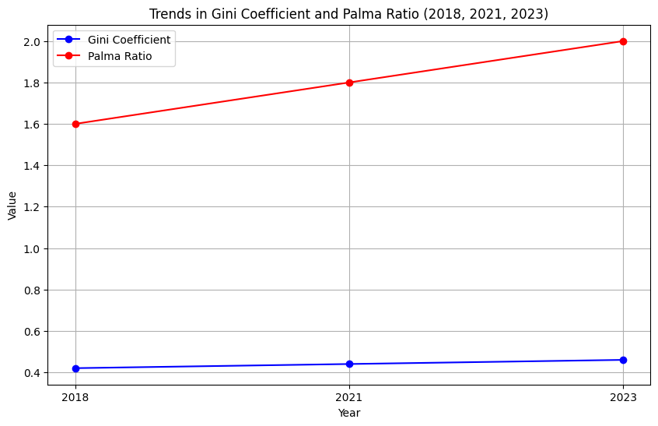
Visual Summary
Trends in Income Inequality (2018-2023)
This visual represents the progression of income inequality in the Philippines over the years 2018, 2021, and 2023. The Gini Coefficient (blue line) and the Palma Ratio (red line) are both key measures of inequality. As we can see, both metrics have shown an increasing trend over the years.
- The Palma Ratio shows a sharper increase, indicating a growing disparity between the richest 10% and the rest of the population.
- The Gini Coefficient also reflects an upward trend, suggesting a gradual but consistent widening of income inequality.
These trends emphasize the pressing need for targeted policy measures aimed at mitigating income disparities, particularly by focusing on economic support for vulnerable groups and regions disproportionately affected by economic and environmental challenges.

Slide 10
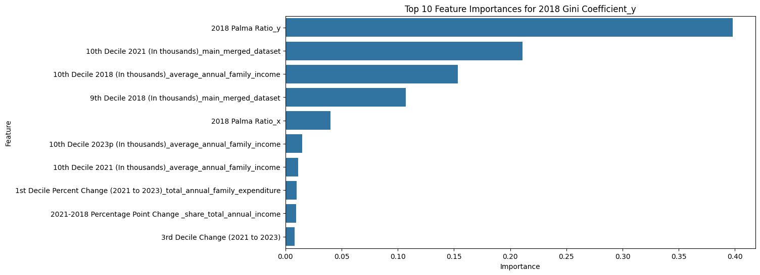
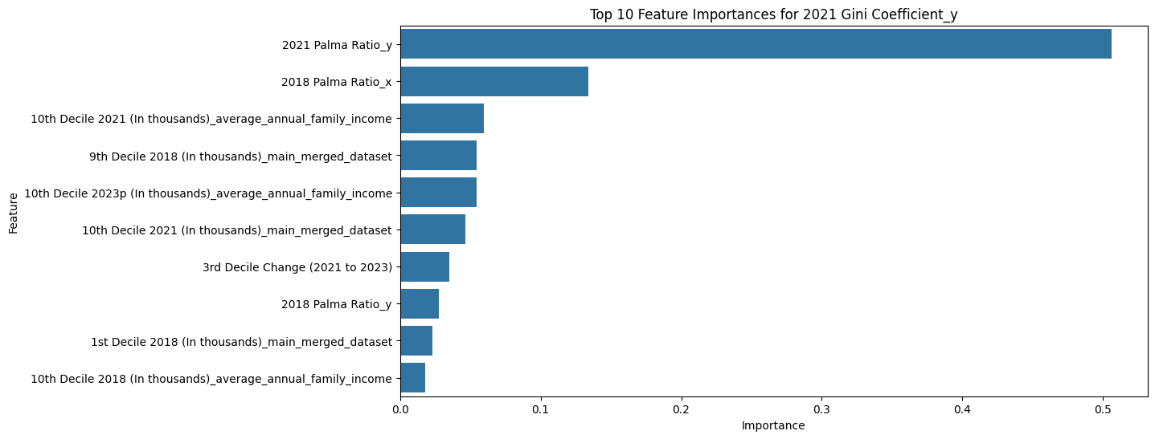

Slide 11
The Bigger Picture
Population growth and climate pressures are major contributors to widening income gaps.
Reducing inequality requires targeted actions such as strengthening social programs and building climate resilience.
Addressing income inequality benefits everyone and promotes stability and prosperity in society

Slide 12
Proposed Actions
Improve social safety nets for vulnerable populations.
Develop climate-resilient infrastructure in impacted regions.
Focus on family planning programs to manage population growth.

Slide 13
Moving Forward
Small actions today can lead to big changes tomorrow.We can reduce inequality by understanding these relationships and working together.

